Slide 1
System Fundamentals
TOPIC 1.0 – SYSTEM FUNDAMENTALS
TOPIC 1
1.1.1 – 1.1.14 Systems in Organizations

Slide 2
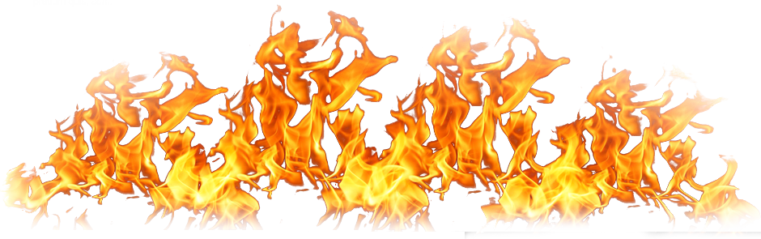
REVIEW REVIEW REVIEW REVIEW REVIEW REVIEW
THE WARM-UP QUESTION
Write a pseudocode algorithm, using an array, that
Outputs each number in the array when divided by the next number in the array

Slide 3
REVIEW REVIEW REVIEW REVIEW REVIEW REVIEW
THE WARM-UP QUESTION
ARR = [5, 10, 2, 6, 9]
loop N from 1 to 5
if N != 0
RESULT = ARR[N-1] / ARR[N]
output RESULT
end if
end loop

Slide 4
TOPIC 1.0 – System FUNDAMENTALS
WHAT IS A SYSTEM?
A set of interacting parts that operate together to achieve some objective or purpose
System has three stages
Input to the system that goes in
The system does something with that input (processes it)
The process creates a result, or output
Input
Process
Output

Slide 5
TOPIC 1.0 – System FUNDAMENTALS
SYSTEMS GALORE
Systems surround us
Electrical System, Telephone System
Other examples?
We can even have systems inside of our own body
Take the digestive system for example
Food
Digestion
Energy/Waste

Slide 6
TOPIC 1.0 – System FUNDAMENTALS
Computer Systems
A computer system is a system of connected computers and peripherals
Printers, scanners, routers
All computers share central storage but can operate independently
Used often with schools, workplaces, agencies
All computers can communicate to share info
What are the benefits of a school or workplace having a system like this?

Slide 7
TOPIC 1.1.1 – Systems IN ORGANIZATIONS
SYSTEM PLANNING
Recall what defines a system
(In a faint whispering voice)
Input to the system that goes in
The system does something with that input (processes it)
The process creates a result, or output
Identify the input and output our system needs
This allows us to plan our system
Also allows us to plan the process that modifies our input

Slide 8
TOPIC 1.1.1 – Systems IN ORGANIZATIONS
SYSTEM PLANNING
TELOS Test
Technical Feasibility – Is our technology sufficient for the proposed solution?
Economic Feasibility – Is our proposed solution cost effective?
Legal Feasibility – Is our proposed solution legal?
Operational Feasibility – Are our practices and procedures sufficient for the proposed solution?
Schedule Feasibility – How long will we wait to implement the new solution?
Planning is highly complex
Often done by Computer Systems Analyst

Slide 9

TOPIC 1.1.2 – Systems IN ORGANIZATIONS
CHANGE MANAGEMENT
When making a change, you break things
Ever update an app and it works worse than before you updated it?
Developing change management policies help to mitigate this
Standard set of procedures for keeping all systems working
Ensures systems don’t go down
Ensures any change made is up to standard (not sloppy)
Provides information and training about the current system
Good change management can make the quality of life for employees much better

Slide 10
TOPIC 1.1.3 – Systems IN ORGANIZATIONS
LEGACY SYSTEMS
Often, it takes a lot to update a system
Companies are resistant to updating because change costs money
Southwest Airlines still runs on Windows 3.1 (myth but this is the kind of stuff companies actually do
Outdated, old computers and programs are kept around
Old programs may not work with new programs
Data cannot be changed to newer format
Does legacy software run on newer hardware?
Is the format compatible with new software?
Can a legacy system use new technology?
Especially peripherals (printers, mice, etc.)

Slide 11
TOPIC 1.1.3 – Systems IN ORGANIZATIONS
Business Mergers
Sometimes, systems are incompatible not due to age, but due to different companies merging
Windows company merges with a MacOS company -> incompatibility
Databases may have trouble being merged
Data must be transformed into one or the other formats
Change Management policies may differ

Slide 12
TOPIC 1.1.3 – Systems IN ORGANIZATIONS
Business Mergers
4 Ways to Integrate new companies
Keep both current systems, develop them both simultaneously
Costly over time
Replace both current systems with a new one
Also costly, but up front
Select best parts of system from each company and combine them
Train both companies to use half of one system and half of another
Select one company’s information system and drop the other
Creates policy problems

Slide 13

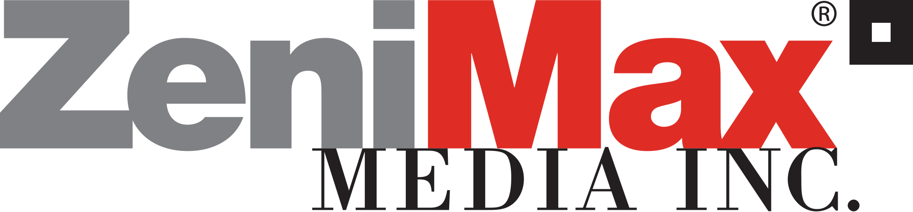
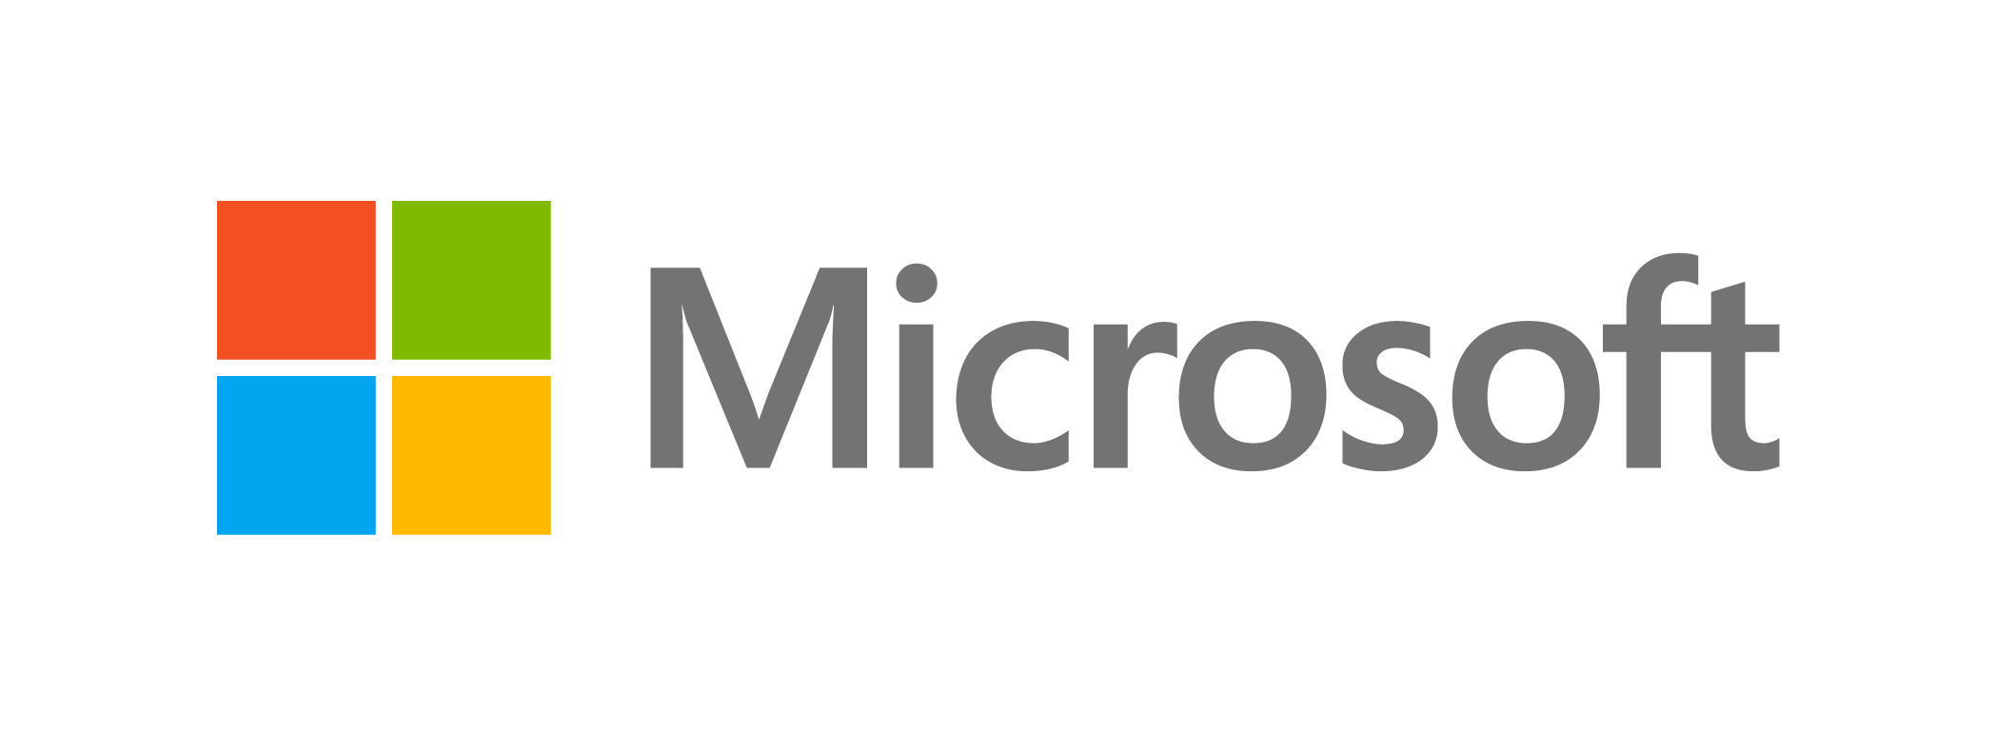

TOPIC 1.1.3 – Systems IN ORGANIZATIONS
Business Mergers eXAMPLE
Let’s take the example of ZeniMax and Tango Gameworks
Tango Gameworks is a Japanese game studio that was aquried by ZeniMax Media, an American game publisher in 2010
ZeniMax was then acquired by Microsoft in 2021
Tango Gameworks was then bought from Microsoft by Krafton, a South Korean game publisher (this happened 2 days ago)
Each company has different ways of storing employee data, backing up files for development, and likely much more
Each country these companies are from like use different software developed for their style of business

Slide 14
TOPIC 1.1.4 – Systems IN ORGANIZATIONS
LOCAL VS REMOTE SYSTEMS
Organizations have the option to run their systems locally (client side)
They can also run their systems remotely/in the cloud (server side)
Local Computing | Cloud Computing
Must buy and upkeep hardware Must buy software Employees must be in house to support hardware and software Building space for servers Electricity to operate servers | Rent hardware from server company Fewer technology employees Only pay for resources used Easier to setup/deploy Improved efficiency Remote access from off-location

Slide 15
TOPIC 1.1.4 – Systems IN ORGANIZATIONS
LOCAL VS REMOTE SYSTEMS
Local Computing – storing and accessing data stored on a computer or server at your location
Cloud Computing – accessing data and programs over the internet (like Google Drive or OneDrive)
Cloud Computing enables Software as a Service (SaaS)
All software and data is stored on the cloud, usually accessed from a web browser
Examples: Google Docs, Facebook, Netflix, Gmail
Other Examples?

Slide 16
TOPIC 1.1.4 – Systems IN ORGANIZATIONS
SAAS BENEFITS/DOWNSIDES
Benefits | Downsides
Easier administration Automatic updates and patch deployment All users access same version of program Globally accessible | Lack of control of pricing Rates can be raised by company Lack of ownership of system Potential security risks Lack of inner knowledge of system

Slide 17
TOPIC 1.1.5 – Systems IN ORGANIZATIONS
INSTALLATION METHODS
When installing a new system, there are multiple ways to begin its use
Direct Changeover – hard switch from old system to new system
Carries a lot of risk, as if new system fails the entire system is down
Works when system isn’t critical and speedy change is best
Employees are fully trained on new system before changeover
Example: Grocery store fully replaces all checkouts overnight and reopens the next day
Parallel Running – old and new systems run simultaneously for a time
Most popular as it carries the lowest risk
Higher cost of running two systems, but can be reverted back if new system fails

Slide 18
TOPIC 1.1.5 – Systems IN ORGANIZATIONS
INSTALLATION METHODS
Phased Conversion – compromise between parallel and direct
New system implemented one piece at a time
Low cost and isolates any potential problems
Because phases are implemented separately, long time to complete
Pilot Running - new system trialed at test location before full rollout
Bank may try new system at one branch before national rollout
Allows for full test but without catastrophic impact of failure
Very cost effective
Usually followed by direct changeover once completed

Slide 19
TOPIC 1.1.6 – Systems IN ORGANIZATIONS
DATA MIGRATION
If companies merge, or move to a new system, what happens to their data?
It must be migrated from one system to the new system, which could have complications
Incomplete Data:
Data could be missing partially or completely
Some data may have been optional in old system and mandatory in new system
Duplicate Data:
Data may be duplicated, leading to multiple instances of one person
Usually well handled by migration tools

Slide 20
TOPIC 1.1.6 – Systems IN ORGANIZATIONS
DATA MIGRATION
Data Non-conformity:
Data from previous system may not fit the requirements of the new system
New system may ask for more information per-person
Inconsistent and Inaccurate Data:
Data may be misrepresented or converted on accident
Think of the way years work given the Y2K incident
Incompatible file formats, data structures, conventions on currency

Slide 21
TOPIC 1.1.7 – Systems IN ORGANIZATIONS
TESTING METHODS
When implementing a new system, we must test it before deployment
Multiple types of testing allow for us to make a system that’s secure and complete
Unit Test – test of an individual part of a system with test data
System Test – testing the overall function of the system
May use software that automates the testing process
Recovery Test – forces the software to fail to verify recovery
Security Test - verifies that security measures properly protect it
Stress Test – make the app demand tons of resources to make sure the system won’t destroy itself

Slide 22
TOPIC 1.1.7 – Systems IN ORGANIZATIONS
TESTING METHODS
Alpha Test - First phase of testing
Includes unit testing and system testing
Beta Test – Second phase of testing
Sample of target audience tries the product
Also called pre-release testing

Slide 23
TOPIC 1.1.7 – Systems IN ORGANIZATIONS
TESTING METHODS
We must combine testing methods to adequately test our software
When testing our philosophy should be to test
Normal Data – our program expects and uses most of the time
Data at the Limits (edge cases) – on the edge of normal and extreme
Extreme Data – data that’s the correct type but not valid
Abnormal/Illegal Data – data that isn’t the correct type for the system
If testing a gradebook program, we would test the grades
60, 70, 80, 90 (normal)
200, -17 (extreme)
0, 100 (at the limits)
$$$, ADSF, (illegal)

Slide 24
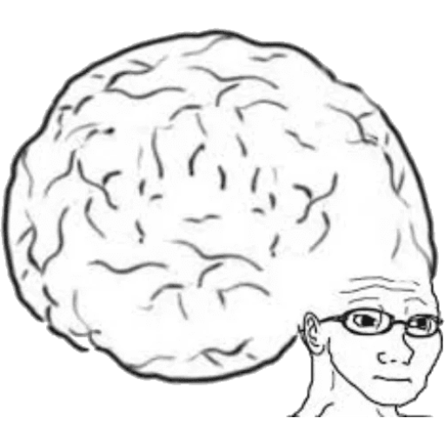
TOPIC 1.1.7 – Systems IN ORGANIZATIONS
VOCAB TO REMEMBER
System
Change Management
Legacy System
Software as a Service
Parallel Running
Pilot Running
Direct Changeover
Phased Conversion
Data Migration
Beta Testing
Unit Test
System Test
Recovery Test
Security Test
Stress Test
Normal Data
Data at the Limits
Extreme Data
Abnormal/Illegal Data
Alpha Testing

